Slide 1
The church
Lesson- 13

Slide 2
The church
OBJECTIVES OF THE LESSON
To understand that people make up the church
To know that Jesus is the head of the church
Commit to be an active member of a local church
DISCUSSION QUESTIONS AT END

Slide 3
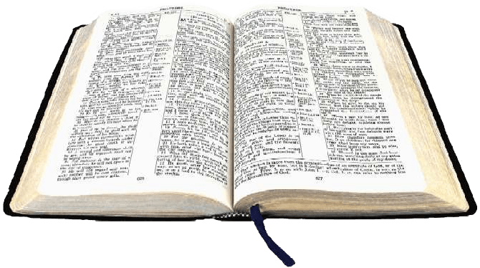
The church
KEY VERSES
And God placed all things under his [Jesus] feet and appointed him to be head over everything for the church, which is his body the fullness of him who fills everything in every way.
Ephesians 1:22-23

Slide 4
The church
What is the church?
Church—from the Greek word ekklesia meaning ones who are “called out” or “separated from” the world.
The church is the community of believers in Jesus who are joined together into one group by the Holy Spirit. The church is not a building; it is the believers from all countries, cultures and generations.
This lesson will cover the church as a whole (the universal Church) and the local church.

Slide 5
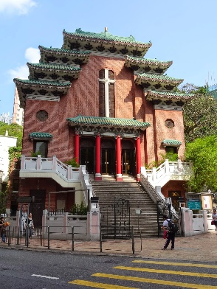
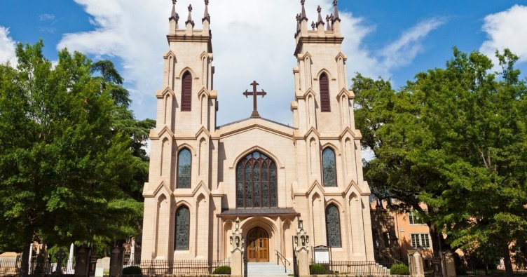
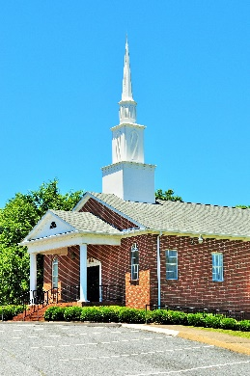
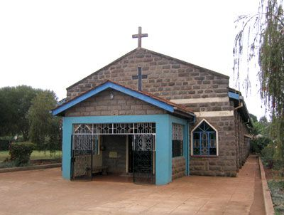
The church
What is the church?
Scripture refers to the Church by several names. Please note these are NOT references to actual names of local churches or denominations—although some may use these names.
The church of God—1 Cor. 1:2, 2 Cor. 1:1
The church of the living God—1 Tim. 3:15
The church of the firstborn—Heb. 12:23
The churches of Christ—Rom. 16:16

Slide 6
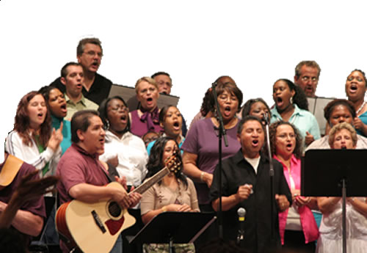
The church
The Church (universal)
God’s people—those looking forward to and trusting in the future Messiah or those looking back to the cross and trusting in Jesus—are all part of the Church.
Read about the uniting of the OT people of God and the saved after Jesus in Ephesians 2:11-12.
Jesus introduced the concept of the church in His teachings (Matt. 16:18, 18:15-20). The book of Acts records the birth and growth of the church among both Jews and Gentiles. Gentiles are all people groups and cultures other than the Jews. Paul was sent to establish churches among Gentile believers and Peter was set to Jewish believers. (1 Thes. 1:1, 1Tim. 3:15).

Slide 7
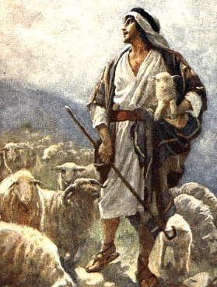
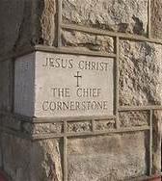
The church
The Church—relation to Jesus
Scriptures describe the Church and its relationship to Jesus with illustrations (word pictures).
A flock and a Good Shepherd—Jesus is the gate by which the sheep (believers) enter into salvation. He is the good shepherd who watches over the sheep; they know him and follow him. He gave His life for the sheep—Jews and Gentiles. (John 10:1-18)
True vine and branches—The Father is the gardener who trims the branches so they bear much fruit. It is by remaining with Jesus (the vine) that we are able to bear fruit. (John 15:1-8)
Building and the Cornerstone—Jesus is the chief cornerstone of the building made up of the believers in Him. The believers, as living stones, are being built into the spiritual house of Jesus. (Ephesians 2:19-22, 1 Peter 2:4-8)

Slide 8
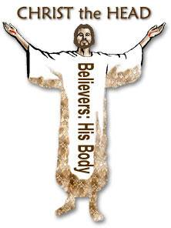
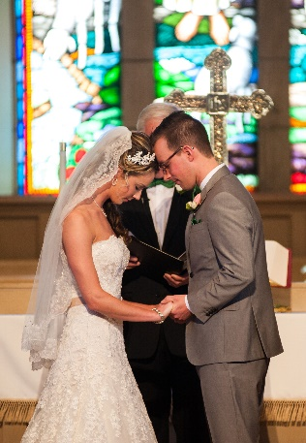
The church
The Church—relation to Jesus
Scriptures describe the Church and its relationship to Jesus with illustrations (word pictures).
A living body and the Head—Jesus is the head of the Church (the body of Christ). He has given gifts of ministry (apostles, prophets, evangelists, pastors, teachers) to believers to enable them to perform works of service toward God and mankind. These works of service unite the believer with Jesus and His Church in a mature and whole relationship. As a member of the Church, each believer is responsible to do his part to build it up.
(1 Corinthians 12, Ephesians 1:22-23, 4:11-16, Colossians 1:18, 2:19)
Bride and Bridegroom—Jesus loves the Church just as a husband is to love his wife. Jesus gave of Himself to make her clean, holy, without blemish and blameless—as a radiant bride.
(Ephesians 5:25-30, Revelation 19:7)

Slide 9
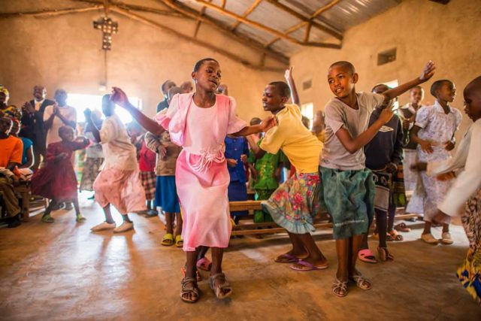
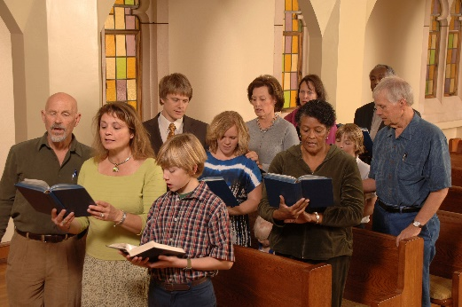
The church
Membership in the Church
The believer is automatically a member of the Church at the moment of belief. Scripture refers to members of the Church by many names.
Saints—2 Cor. 13:13, Phil. 1:1, 4:21-22
Brothers/Sisters—Rom. 10:1, 12:1, Col. 1:2, Jas. 1:2, 2 Pet. 1:10
Christians—Acts 11:26, 26:28, 1 Pet. 4:16
Believers—1 Tim. 4:12
Disciples—Matt. 10:42
Chosen people—1 Pet. 2:9, Rev. 17:14
Royal priesthood—1 Pet. 2:5, 9
Holy nation—1 Pet. 2:9
Ambassadors—2 Cor. 5:20
Workmen—Matt. 9:37-38, 2 Tim. 2:15

Slide 10
The church
Its purpose and mission
The primary mission of the Church is to distribute the truth (Word of God) to the world—both the saved and the lost.
Read Acts 20:20-21, 1 Tim. 3:15, 2 Tim. 4:1-4
His intent was that now, through the church, the manifold wisdom of God should be made known to the rulers and authorities in the heavenly realms, according to his eternal purpose which he accomplished in Christ Jesus our Lord. (Eph. 3:10-11)
The purpose and mission of the Church is extensive—it covers all relationships which include ministry to God, other believer and the world.

Slide 11
The church
Ministry to believers—nurture
Therefore, as God’s chosen people, holy and dearly loved, clothe yourselves with compassion, kindness, humility, gentleness and patience. (Col. 3:12)
The church is to minister to one another in an effort to encourage and build up each other in the grace and knowledge of Jesus Christ. This type of ministry involves caring for each other—or nurturing. The following are ways to minister to other believers.
Love one another deeply, from the heart—1 Pet. 1:22, 1 Jn. 3:14
Allow for restoration—2 Cor. 2: 5-11, Col. 3:13-14
Encourage each other—Heb. 10:25
Share with each other—Acts 4:32-35
Show proper respect for everyone—1 Pet. 2:17
Care for needs—1 Tim. 5:1-16, 1 Jn. 3:17
Do good in the world—Gal. 6:10
Teach in wisdom—Eph. 4:14-16
Its purpose and mission
Ministry to God—worship
Therefore, I urge you, brothers, in view of God’s mercy, to offer your bodies as living sacrifices, holy and pleasing to God—this is your spiritual act of worship. (Rom. 12:1)
The Church is to minister to God which involves worship, adoration and thanksgiving—through prayer, praise, song and in all things.
(Eph. 5:19-20, Col. 3:16-17, 1 Jn. 5:2)
Ministry to the world—evangelism and mercy
But you will receive power when the Holy Spirit comes on you; and you will be my witnesses in Jerusalem, and in all Judea and Samaria, and to the ends of the earth. (Acts 1:8)
The Church is to minister to God which involves worship, adoration and thanksgiving—through prayer, praise, song and in all things.
(Matt. 28:18-20, 1 Thes. 2:8, 2 Tim. 4:2)

Slide 12
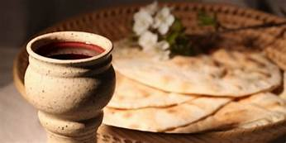
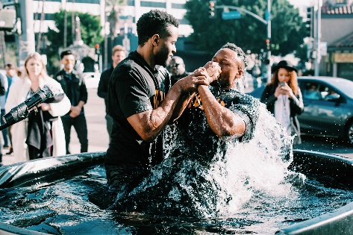
The church
Ordinances (ceremonies) of the Church
The Lord’s Supper (Communion, Holy Communion, Breaking of Bread)
Jesus instituted the Lord’s Supper in conjunction with His observance of the Passover, a celebration described in the OT.
The Passover was a special meal observed once a year as a reminder of God’s deliverance from slavery in Egypt (Ex. 12:1-30). Jesus established the Lord’s Supper for all Christians (1 Cor. 11:23-26). It is a reminder of His sacrifice to redeem and justify mankind.
This special meal became a custom almost immediately and is regularly observed weekly, monthly, or quarterly depending on the local church. It is a time of worship, self-examination and remembrance.
Matt. 26:26-29, Mk. 14:22-26, Lk. 22:14-20, 1 Cor. 11:23-33
Water Baptism
The act of professing your belief in Jesus’ sacrifice and acceptance of His Lordship in your life by being immersed in water. Early believers practiced this custom and Jesus endorsed its practice through His own baptism and the command to baptize future believers.

Slide 13
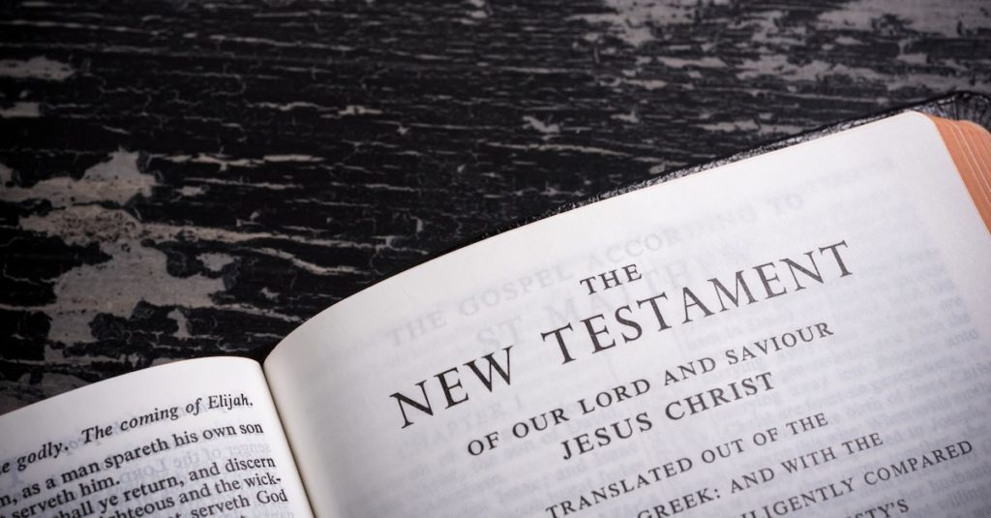
The church
Local church
The NT teaches the local church (believers) to be pleasing in the sight of God and to live godly lives. It also encourages them to continue in their faith. The Gospels (Matthew, Mark, Luke, John) record Jesus’ teachings about the church, Acts records the history or the church, and the letters (Romans, Corinthians, Galatians, Ephesians, Philippians, Colossians, Thessalonians) were written to specific local churches to address problems and provide solutions and sound teaching. The other books were written to encourage believers (Timothy, Titus, Philemon, Hebrews, James, Peter, John, Jude). Revelation describes what happens to the church in the end times.

Slide 14
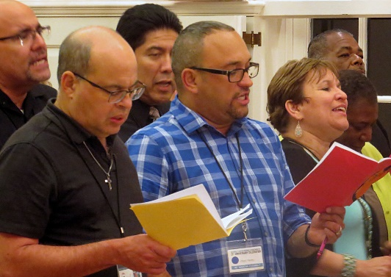
The church
Local church
The local church—its organization
The local church is composed of like-minded believers meeting together withing a community. The local churches are sometimes called “congregations.” There may be more than one local church within a community. God has given gifts of service to the believers of each church to allow it to operate as a complete living entity. These gifts are apostles, prophets, evangelists, pastors and teachers.
To prepare God’s people for works of service so that the body of Christ may be built up until we all reach unity in the faith and in the knowledge of the Son of God and become mature, attaining to the whole measure of the fullness of Christ. (Eph. 4:12-13)

Slide 15
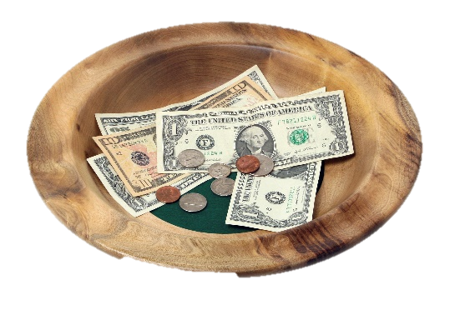
The church
Local church
The local church—its organization
The local church operates like a body with each member doing his/her part—just as each part of the human body does its part—to make the whole complete. It is self-governing, self propagating, and self financing. Each member provides financial support to his local church and other churches as needed.
From Him [Jesus] the whole body, joined and held together by every supporting ligament, grows and builds itself up in love, as each part does its work. (Eph. 4:16)
Now we are the body of Christ, and each one of you is a part of it.
(1 Cor. 12:27)

Slide 16
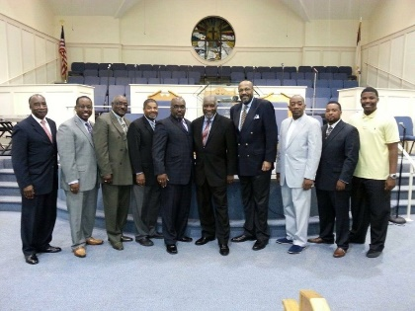
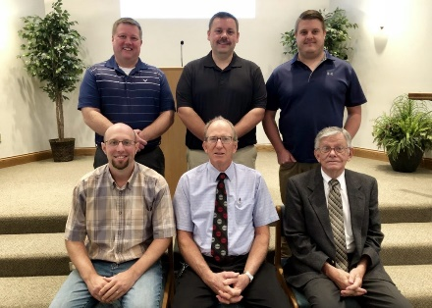
The church
Local church
The local church—its leadership
Scriptures identify elders and deacons as leaders in the local church.
Their qualifications are set forth in the following Scriptures: Acts 6:1-6, 1 Tim. 3:1-14, 5:17, Tit. 1:6-9, 1 Pet. 5:1-11 and Jas. 5:14-15.
These qualifications can be broken down into four categories.
Spiritual—must have a personal relationship with Christ, must have a recognized calling from God to shepherd His people
Character—their life must be consistent with Scripture, must be known by good character in the church and community
Family—their household must be a model of Christian values and conduct
Ministry—must desire to serve God and others, must be faithful to the Bible, able to teach and willing to act as a shepherd for those in the church

Slide 17
The church
Local church
The local church—its leadership
Elder (overseer or bishop)—give counsel and leadership to those in their church. This is a position requiring sound judgement and God-given authority. All early churches mentioned in Scripture had more than one elder.
Deacon—selected by the members of the church. Similar responsibilities to an elder but more physical in nature—visiting those who cannot come to church because of age or ailment, providing aid to those in need, taking care of the church building, etc.

Slide 18
The church
Local church
You also, like living stones, are built into a spiritual house to be a holy priesthood offering spiritual sacrifices acceptable to God through Jesus Christ.
1 Peter 2:5
Jan
Brian
Sarah
Valerie
Anne
Samuel
Jonathan
Marcie
Mae
Martha
Philip
Peg
David
Barry
Eleanor
Moses
Nathan
Conner
Jesse
Tom
Paul
Ed
John
Abigail
Lillie
Jo
Amy
Kathy
Bob
Beth
Joan
Victor
Kyle
Tony
Mary
Hannah
Marcus
Deacon
Elder
Elder
Deacon
Apostles
Prophets
Jesus

Slide 19
The church
A healthy, growing church
The church is a living organism—made up of people (not buildings). As people must grow to stay healthy, so must a church grow. The goal of growth is to make new disciples and save those that are lost—not just to increase numbers of people and have a larger church.
Then Jesus came to them and said: “All authority in heaven and on earth has been given to me. Therefore go and make disciples of all nations, baptizing them in the name of the Father and of the Son and of the Holy Spirit, and teaching them to obey everything I have commanded you. And surely I am with you always, to the very end of the age.” (Matt. 28:18-20)
Growth is a continuous cycle. The four basic phases of growth for a healthy church are internal growth, expansion, extension and bridging growth.

Slide 20
The church
A healthy, growing church
Internal growth–Believers grow in Christ’s character by practicing the fruit of the Spirit and the gifts and callings of God. As members mature, they are filled with new strength to live a life pleasing to God. This leads to
Expansion growth—This involves continuously adding new believers from the community through preaching the Gospel. Through expansion the church is ready for
Extension growth—This multiplies itself and results in new churches within the same culture. The new churches undergo internal growth and the cycle continues.
Bridging growth (missions)—This occurs when a church extends its witness and church planting beyond its own culture—ministering to other people groups and nations. As this is accomplished new churches begin the cycle again.

Slide 21
The church
A healthy, growing church
The Cycle of Church Growth and
Church Planting
Church 1
Internal
growth
Expansion
growth
Extension
growth
Bridging
growth
Church 2
Missionary sent
Internal
growth
Expansion
growth
Extension
growth
Bridging
growth
Stage 1—Pioneer
New church planted
Stage 2—Parent
Missionary sent
Stage 3—Partner
Stage 1—Pioneer
Stage 4—Participant
Stage 2—Parent
Stage 3—Partner
Stage 4—Participant

Slide 22
The church
DISCUSSION
QUESTIONS

Slide 23
The church
Explain the meaning of the church—both the universal church and the local church.
What are the ordinances common to the Christian churches?
What leadership positions are present in the organization of the church? Discuss the qualifications for each.
Why is it important for the church to grow and stay healthy?

Slide 24
The church
APPLICATION
Memorize Ephesians 1:22-23
Consider whether you life would meet the requirements of elder or deacon. If not, how does your life need to change to qualify for one of these positions?
Read Paul’s farewell to the elders at Ephesus in Acts 20:13-38. List his concerns, cautions, commands and comments.
Fill in the blank illustration of the church with names of the “living stones” in your local church. Be sure to include the church leadership in the foundation stones.

Slide 25
The church
Local church
You also, like living stones, are built into a spiritual house to be a holy priesthood offering spiritual sacrifices acceptable to God through Jesus Christ.
1 Peter 2:5
Apostles
Prophets
Jesus

Slide 26
The church
Contact: Info@Equippersgroup.org

